Slide 1
User-level threads &
Scheduler Trace
- 개발 환경 설정 및 실습 -
국민대학교 임베디드 연구실
경주현
2017 LG MC 인재육성팀 교육

Slide 2
Outline
개발환경 설정
트레이스 실습
User-level threads
User-level threads 트레이스 실습

Slide 3
개발환경
윈도우 또는 리눅스
Virtualbox 리눅스
qemu 리눅스
(가상의 안드로이드 단말기)

Slide 4
스케줄러 개발 환경
Virtual Box 설치
리눅스 이미지 다운로드
https://goo.gl/DMtLp8
실행

Slide 5
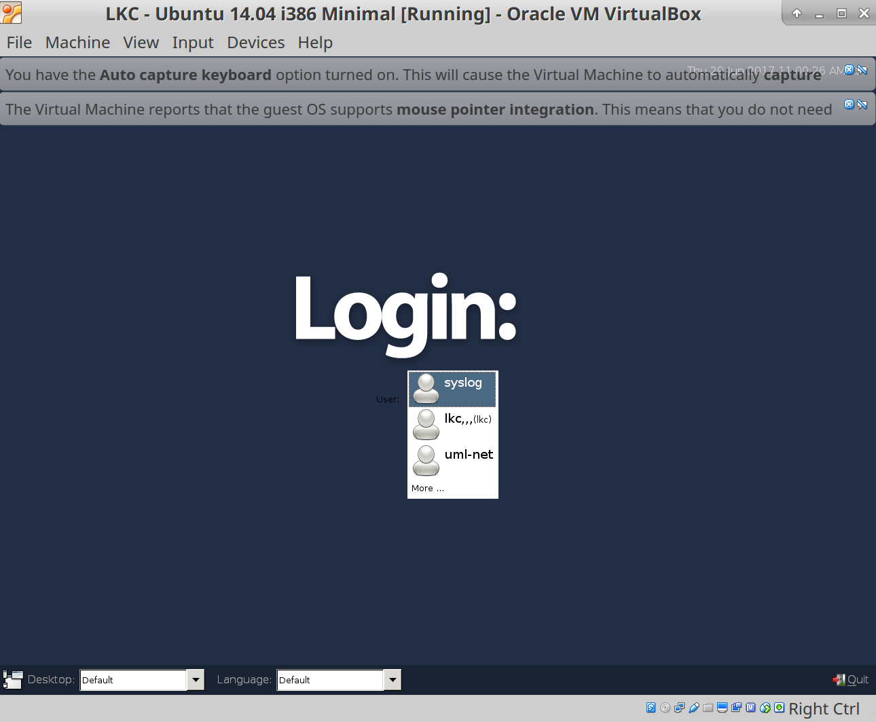

Slide 6
SSH를 이용하여 로그인
ssh lkc@localhost -p 22022
ID : lkc
PW : lkc201^

Slide 7
커널 소스 위치
/home/lkc/Desktop/linux-linaro-stable
Rootfs 위치
/home/lkc/Desktop/linux-linaro-stable/rootfs/initrd

Slide 8
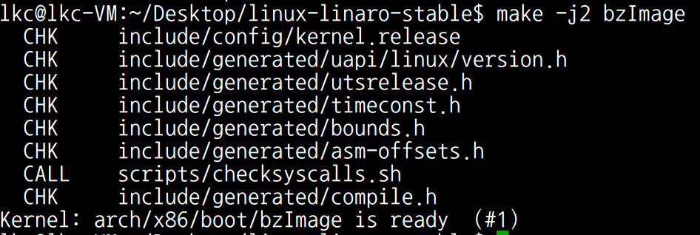
커널 컴파일
cd ~/Desktop/linux-linaro-stable
make -j2 bzImage

Slide 9
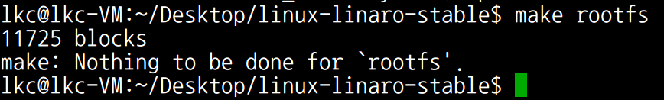
rootfs 컴파일
cd ~/Desktop/linux-linaro-stable
make rootfs

Slide 10
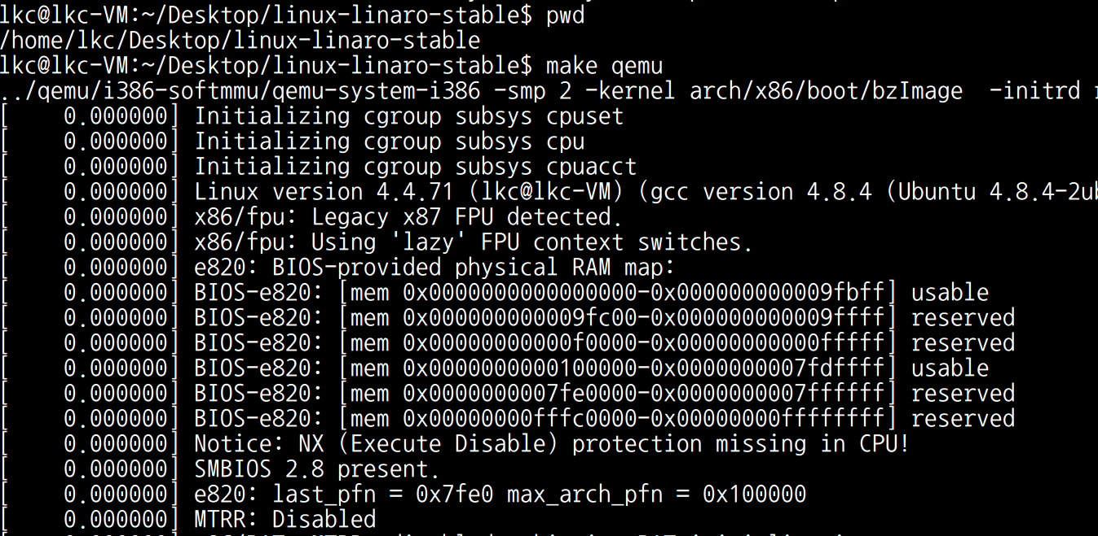
커널 실행
cd ~/Desktop/linux-linaro-stable
./prepare.sh
make qemu

Slide 11
Qemu key commands
Ctrl + a, x : qemu 종료.
Ctrl + a, c : qemu mode와 os mode로 전환
info : 실행되고 있는 환경에서의 정보를 볼 수 있음
info pg : 실행되고 있는 page table 정보(실습을 위해 추가함)
info cpus : 실행되고 있는 cpu 정보

Slide 12
설정 확인
파일공유
VirtualBox linux <-> qemu linux
VirtualBox linux nfs 디렉토리 위치
/nfs
qemu linux nfs 디렉토리 위치
/nfs
파일 생성 후 타겟에서 확인
VirtualBox linux$ touch /nfs/test
qemu linux$ ls /nfs/

Slide 13
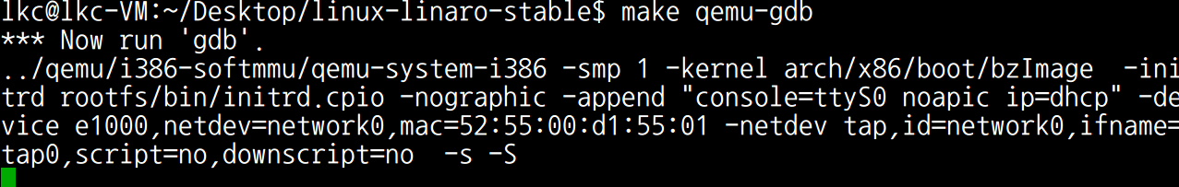
kernel + gdb stub 실행
make qemu-gdb

Slide 14
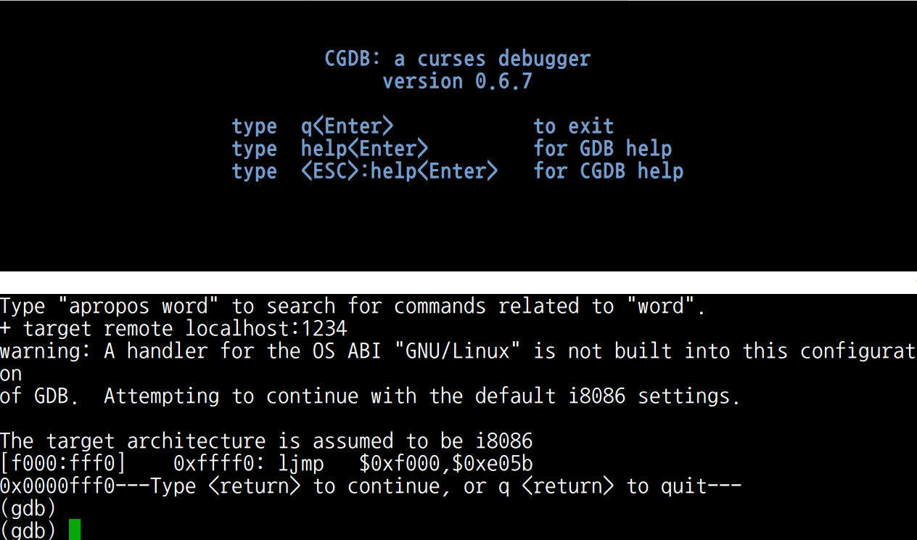
gdb client 실행
cgdb

Slide 15
커널 디버깅
GDB Key Commands
b + simbol_name : breakpoint
n : next step
si : next instruction step
ctrl + c : stop
c : continue
커널 디버깅을 위한 GDB Commands 실습
1. make qemu-­gdb
2. break 포인트 설정 (start_kernel)
3. single step (s)
4. backtrace (bt)

Slide 16
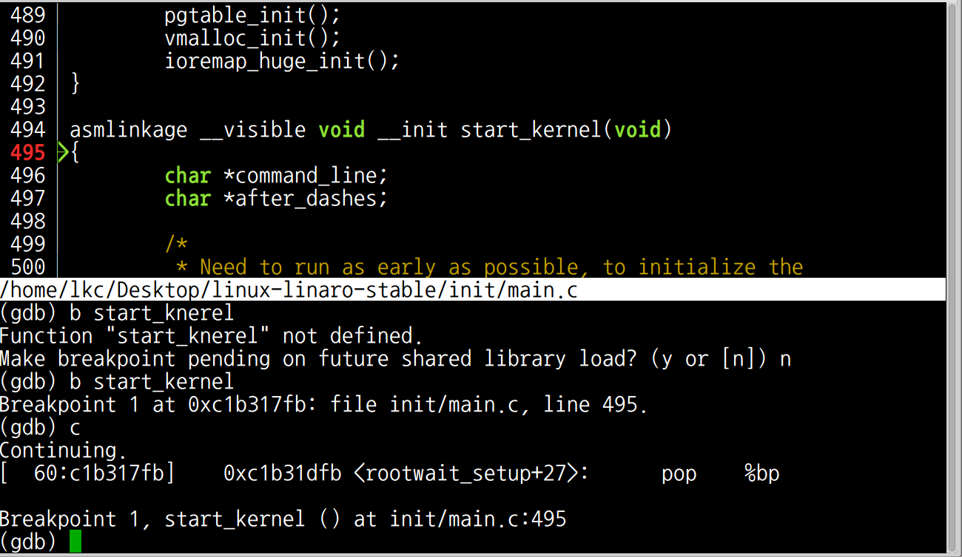
b start_kernel
커널 디버깅 실습
b start_kenrel
c

Slide 17
커널 트레이스
trace-cmd + kernelshark
http://elinux.org/images/6/64/Elc2011_rostedt.pdf

Slide 18
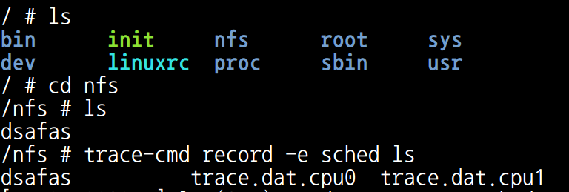
Scheduler 트레이스 - qemu linux
#>trace-cmd record -e sched <프로그램>

Slide 19
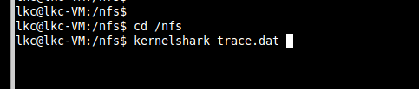
Scheduler 트레이스 확인 - VirtualBox linux
cd /nfs
kernelshark trace.dat

Slide 20
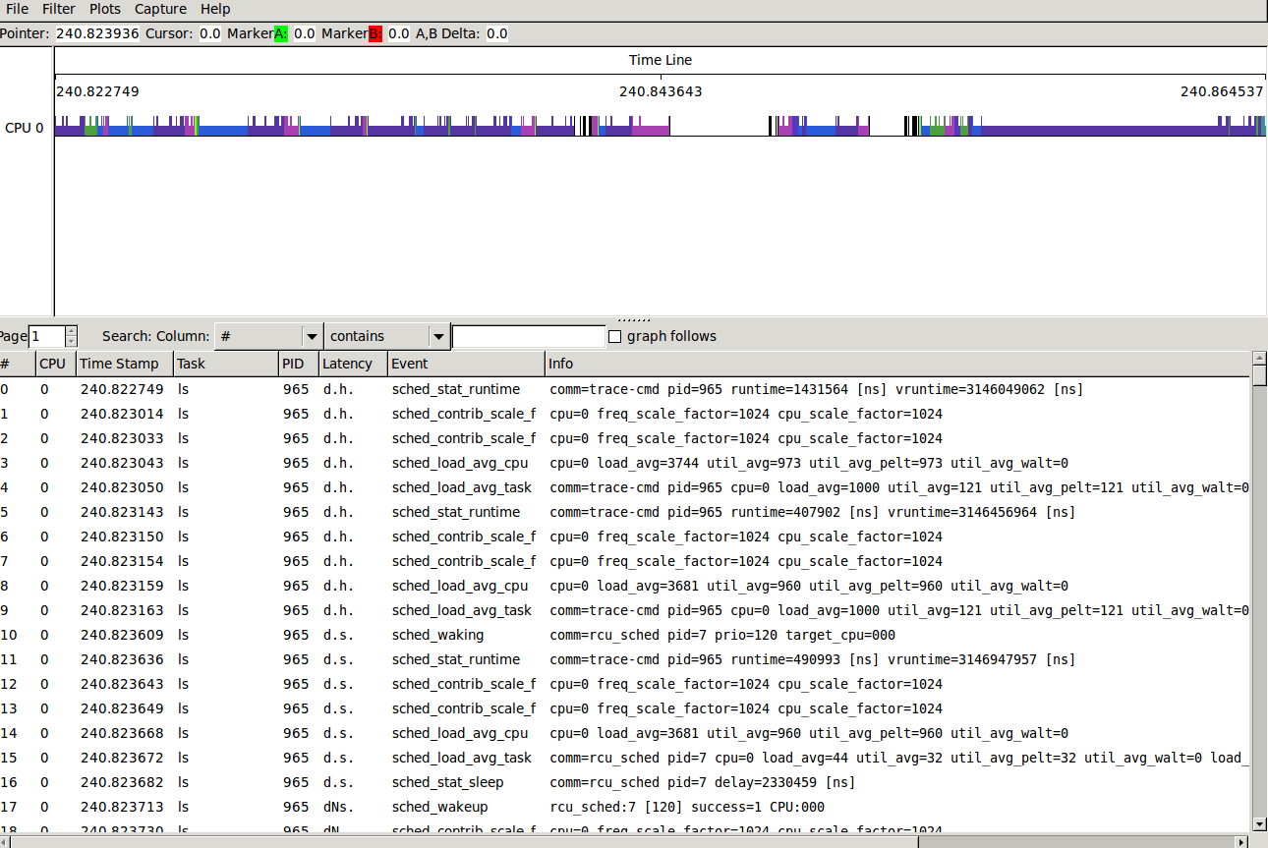
Scheduler 트레이스 확인 - VirtualBox linux

Slide 21
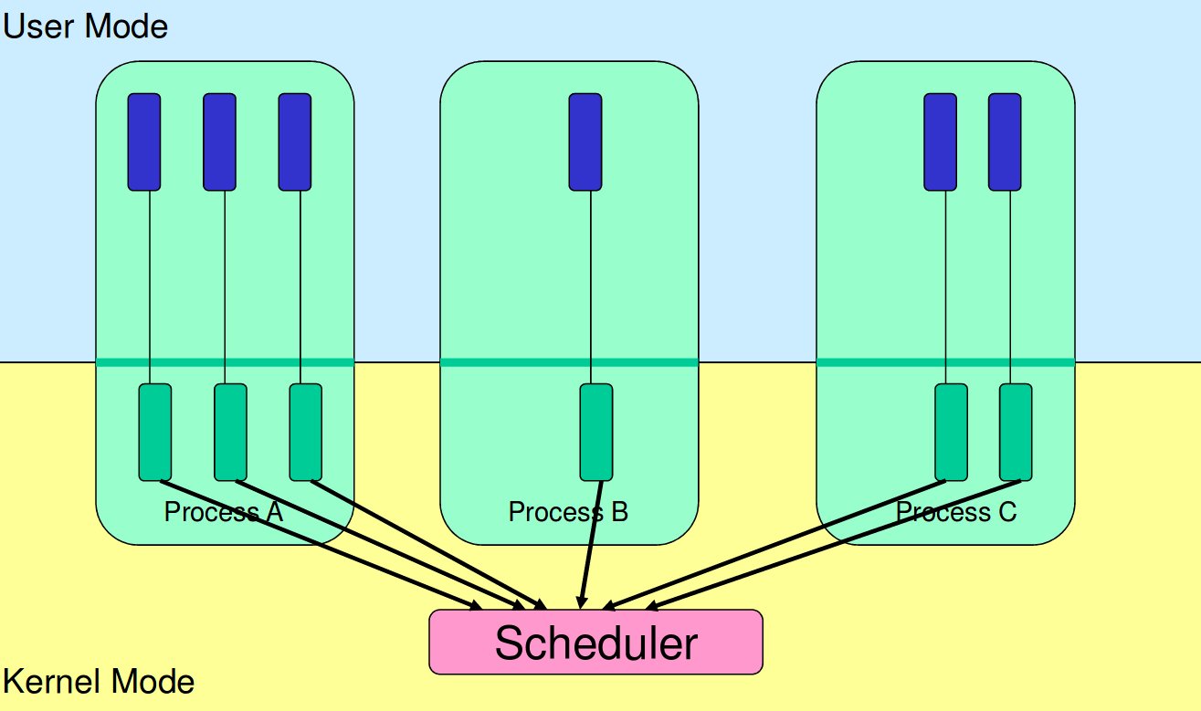
Kernel-level thread
https://cgi.cse.unsw.edu.au/~cs3231/12s1/lectures/SchedulerActivations.pdf

Slide 22
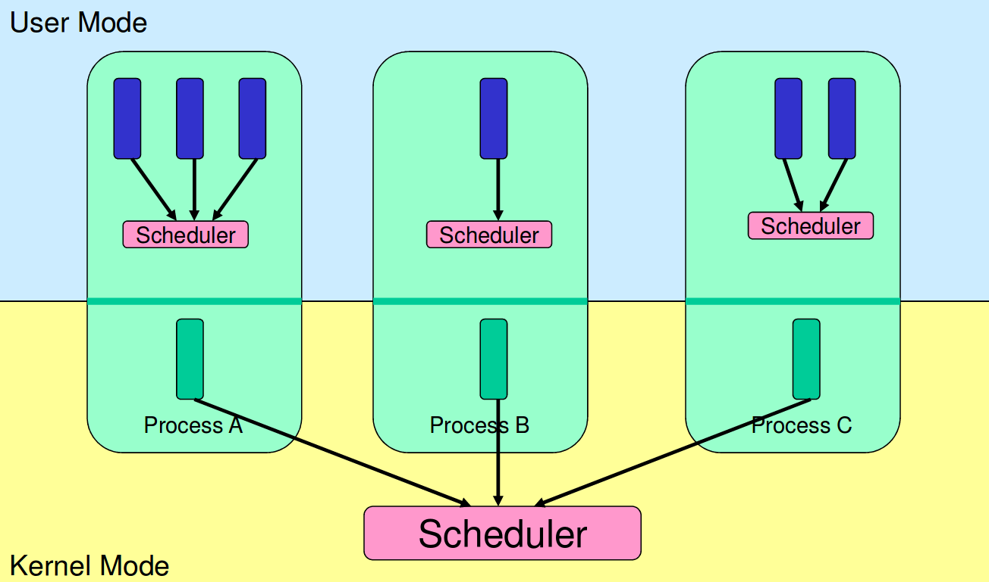
User-level thread

Slide 23
User-level threads
Thread 1
Thread 2
https://cgi.cse.unsw.edu.au/~cs3231/12s1/lectures/SchedulerActivations.pdf
https://pdos.csail.mit.edu/6.828/2016/homework/xv6-uthread.html
OS

Slide 24
Why talk about user-level threads?

Slide 25
User-level threads
C/W in User-level threads
mimics modern kernel level C/W.

Slide 26
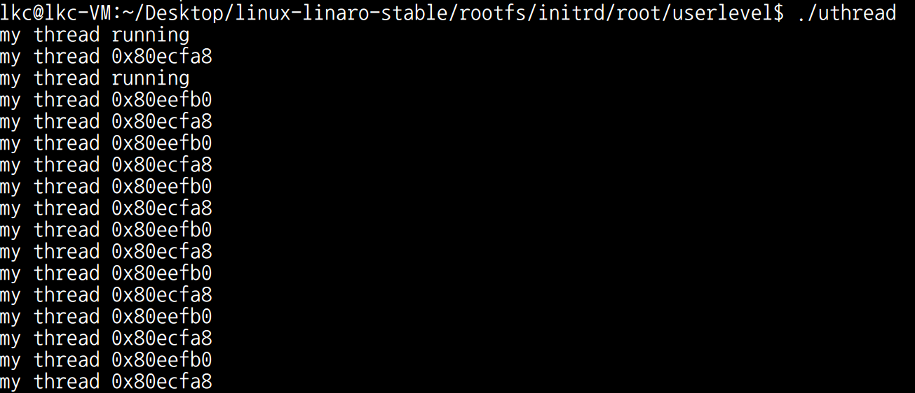
Source
/home/lkc/Desktop/linux-linaro-stable/rootfs/initrd/root/userlevel
Makefile thread_switch.S uthread uthread.c
Compile
make
run
./uthread

Slide 27
How to implement an O/S?

Slide 28
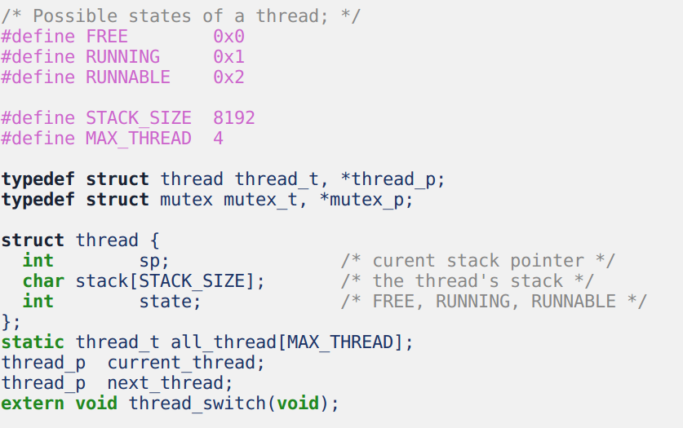
Task structure & Task State
/home/lkc/userlevel
컴파일
실행

Slide 29
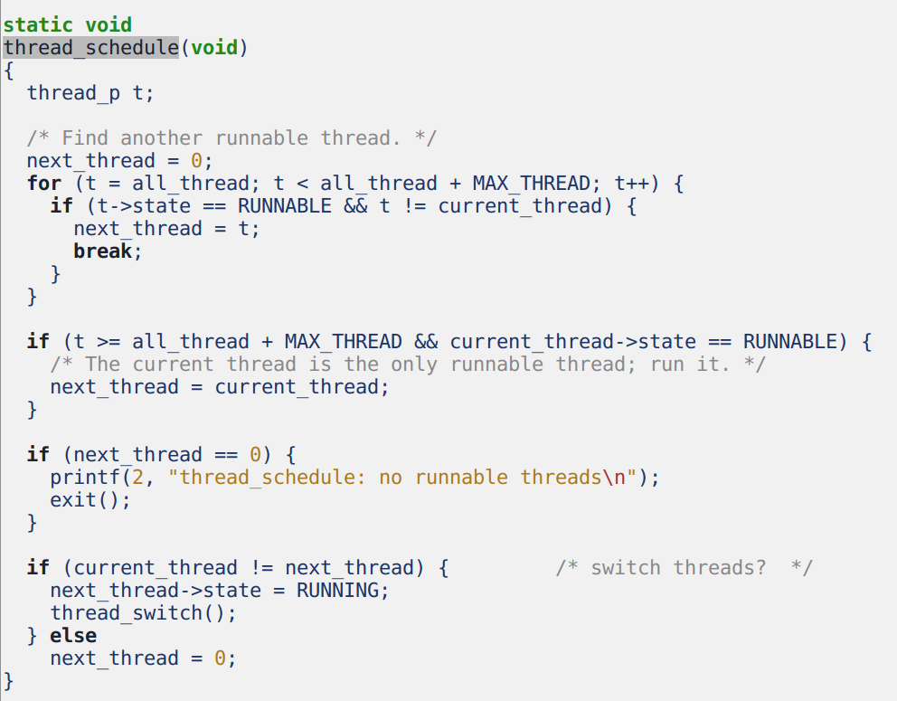
Schedule and Context switch

Slide 30
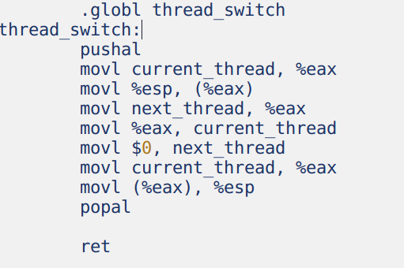
Context Switch
struct thread
-------------------- | 4 bytes for state| -------------------- | stack size bytes | | for stack | -------------------- | 4 bytes for sp | -------------------- <--- current_thread ...... ...... -------------------- | 4 bytes for state| -------------------- | stack size bytes | | for stack | -------------------- | 4 bytes for sp | -------------------- <--- next_thread

Slide 31
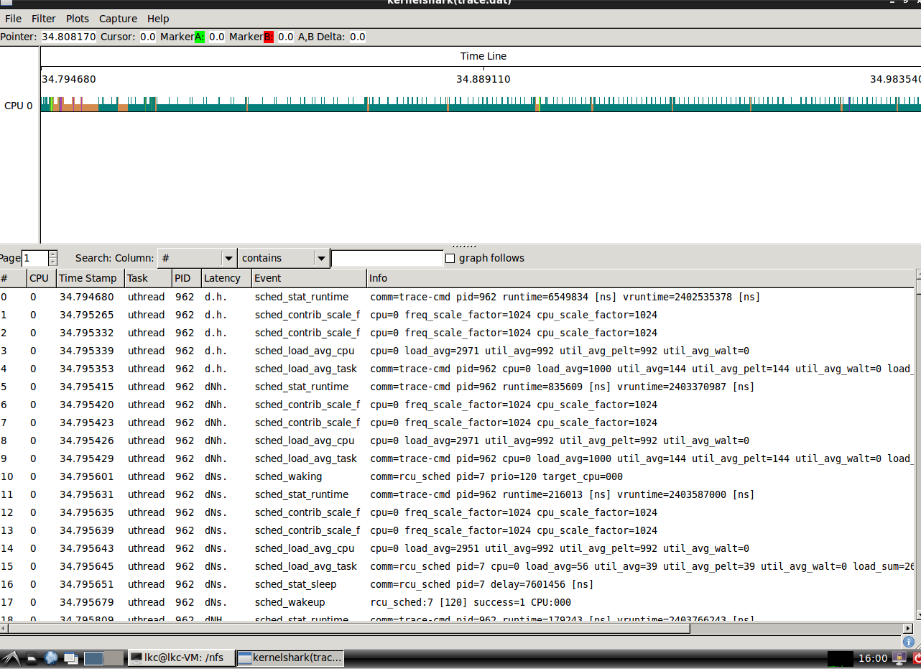
User-level threads trace 실습

Slide 32
User-level threads
Pro :
Fast thread management (creation, deletion,
switching, synchronisation...)
Cons :
Blocking blocks all threads in a process
page fault
system call
No thread-level parallelism on multiprocessor
Solution: Scheduler Activations
Real world
M:N model, today google go language
https://intl.aliyun.com/forum/read-916
co-routines
https://www.youtube.com/watch?v=YYtzQ355_Co
http://www.gamedevforever.com/291

Slide 33

Next Step.
Energy-aware scheduling: EAS
CFS scheduler - Kernel level
Load Balancer(Group Scheduling, Bandwidth Control, PELT)
EAS features

Slide 34
Reference
https://pdos.csail.mit.edu/6.828/2016/schedule.html
http://web.mit.edu/6.033
http://www.rdrop.com/~paulmck/
“Is Parallel Programming Hard, And If So, What Can You Do About It?”
Davidlohr Bueso. 2014. Scalability techniques for practical synchronization primitives. Commun. ACM 58
http://queue.acm.org/detail.cfm?id=2698990
"CPUFreq and The Scheduler Revolution in CPU Power Management", Rafael J. Wysocki
https://sites.google.com/site/embedwiki/oses/linux/pm/pm-qos
https://intl.aliyun.com/forum/read-916
User-level threads : co-routines
http://www.gamedevforever.com/291
https://www.youtube.com/watch?v=YYtzQ355_Co
Scheduler Activations
https://cgi.cse.unsw.edu.au/~cs3231/12s1/lectures/SchedulerActivations.pdf
https://en.wikipedia.org/wiki/FIFO_(computing_and_electronics)
http://jake.dothome.co.kr/
http://www.linuxjournal.com/magazine/completely-fair-scheduler?page=0,0
https://www2.cs.uic.edu/~jbell/CourseNotes/OperatingSystems/6_CPU_Scheduling.html
"Energy Aware Scheduling", Byungchul Park, LG Electronic
“Update on big.LITTLE scheduling experiments”, ARM
“EAS Update” 2015 september ARM
"EAS Overview and Integration Guide”, ARM TR
“Drowsy Power Management”, Matthew Lentz, SOSP 2015
https://www.slideshare.net/nanik/learning-aosp-android-hardware-abstraction-layer-hal
https://www.youtube.com/watch?v=oTGQXqD3CNI
https://www.youtube.com/watch?v=P80NcKUKpuo
https://lwn.net/Articles/398470/
“SCHED_DEADLINE: It’s Alive!”, ARM, 2017

